Slide 1
Topic: Measurement EQ: How do I calculate the area of Composite shapes?
Year 11 Essentials

Slide 2
Things Required For This Lesson
Interactive Notebook
Textbook: Interleaved Maths Essential Connections
Ruler, Red Pen, Pencil, Pens, Scientific Calculator
Growth mindset

Slide 3
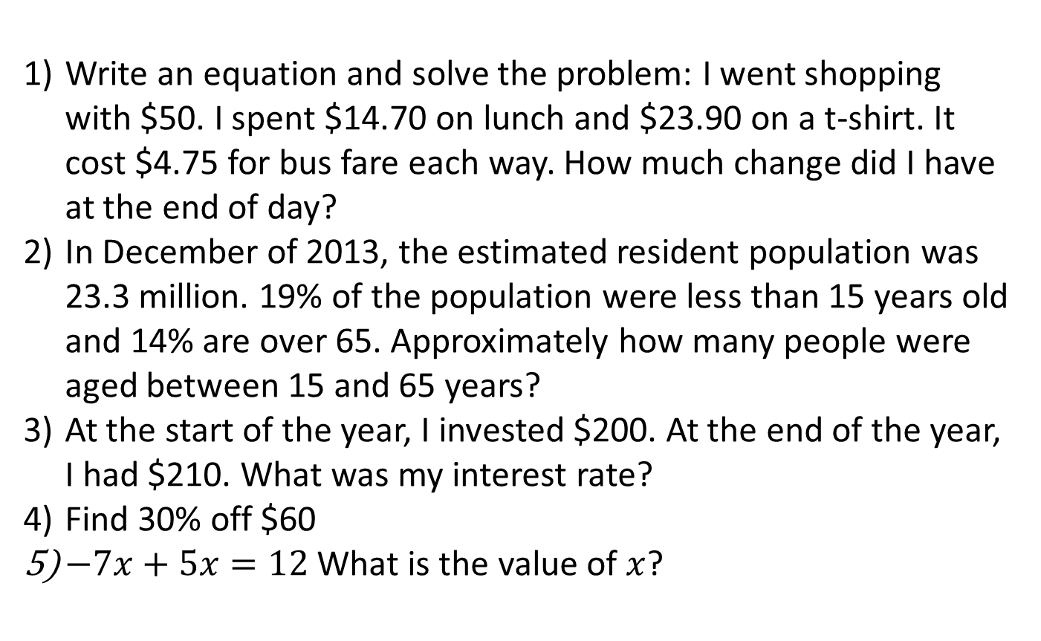
First 5
Answers
1) $50- ($14.70 + $23.90 + $4.75 x 2) = $1.90
2) Approx 15.6 mil
3) 5%
4) $18
5) -6
Write an equation and solve the problem: I went shopping with $50. I spent $14.70 on lunch and $23.90 on a t-shirt. It cost $4.75 for bus fare each way. How much change did I have at the end of day?
In December of 2013, the estimated resident population was 23.3 million. 19% of the population were less than 15 years old and 14% are over 65. Approximately how many people were aged between 15 and 65 years?
At the start of the year, I invested $200. At the end of the year, I had $210. What was my interest rate?
Find 30% off $60
$−7x+5x=12$What is the value of $x$?

Slide 4
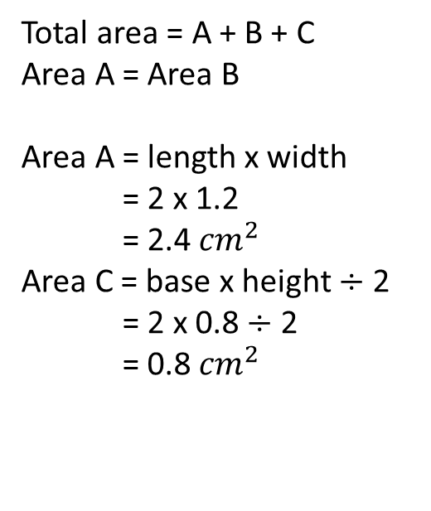

24
7
30
Topic: Measurement
EQ: How do I calculate the area of composite shapes?
What is a composite shape?
A composite shape is a combination of different shapes.
2cm
1.2cm
Total area = A + B + C
Area A = Area B
Area A = length x width
= 2 x 1.2
= 2.4 ${cm}^{2}$
Area C = base x height $÷$ 2
= 2 x 0.8 $÷$ 2
= 0.8 ${cm}^{2}$
How do I solve the area of a composite shape?
1.2cm
A
B
2cm
C
C has a base of 2cm and a height of 0.8cm. ( 2cm -1.2cm)
WICOR
Total area = A + B + C
= 2.4 + 2.4 + 0.8
= 5.6 ${cm}^{2}$

Slide 5
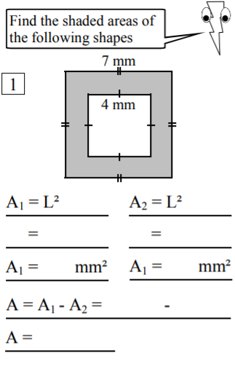
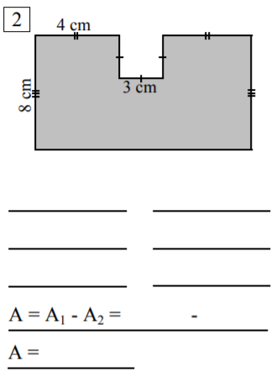
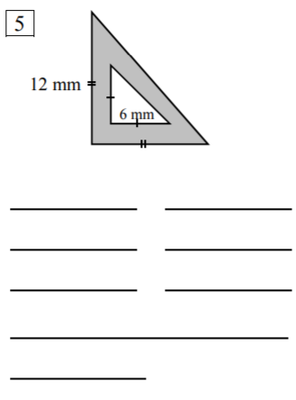
Complete pages 68 and 69 on the Textbook
Finished? Have a go at these:

Slide 6

Thank you
Keep up the good work!

